Slide 1
Connectionist Computing
COMP 30230/41390
Gianluca Pollastri
office: CASL, ground floor Science East.
email: gianluca.pollastri@ucd.ie
Connectionist Computing COMP 30230

Slide 2



Credits
Geoffrey Hinton, University of Toronto.
  borrowed some of his slides for “Neural Networks” and “Computation in Neural Networks” courses.
Ronan Reilly, NUI Maynooth.
  slides from his CS4018.
Paolo Frasconi, University of Florence.
  slides from tutorial on Machine Learning for structured domains.
Connectionist Computing COMP 30230

Slide 3
Lecture notes on Moodle
https://csmoodle.ucd.ie/moodle/course/view.php?id=288
Strictly confidential...
Enrolment key: 30230cc
Connectionist Computing COMP 30230

Slide 4
Books
No book covers large fractions of this course.
Parts of chapters 4, 6, (7), 13 of Tom Mitchell’s “Machine Learning”
Parts of chapter V of Mackay’s “Information Theory, Inference, and Learning Algorithms”, available online at:
http://www.inference.phy.cam.ac.uk/mackay/itprnn/book.html
Chapter 20 of Russell and Norvig’s “Artificial Intelligence: A Modern Approach”, also available at:
http://aima.cs.berkeley.edu/newchap20.pdf
More materials later..
Connectionist Computing COMP 30230

Slide 5
Marking
3 landmark papers to read, and submit a 10-line summary on Moodle about: each worth 6.67%
a small connectionist tool to build and play with: 30%
Final exam: 50%
Connectionist Computing COMP 30230

Slide 6
Programming assignment
Implement a Multi-Layer Perceptron, test it.
The description on Moodle.
Submit through Moodle code and test results by April the 28th at 23:59, any time zone of your choice (Baker Island?).
30% of the overall mark
One third of a grade down every day late, that is: if you deserve an A and you’re 1 day late you get an A-, 2 days late a B+, etc.
Connectionist Computing COMP 30230

Slide 7
Assignment 2
Read the paper “Finding structure in time”, by Elman (1990), up to and excluding the Discovering the notion "word" section.
The paper is on Moodle.
Submit a 250 word MAX summary by April the 4th at 23:59 on Moodle, any time zone of your choice (Baker Island?).
5% of the overall mark
1/3 of a grade down every day late, that is: if you deserve an A and you’re 1 day late you get an A-, 2 days late a B+, etc.
You are responsible for making sure I get it..
Connectionist Computing COMP 30230

Slide 8
Fighting overfitting: combining networks
Averaging the predictions of many different networks is a good way to avoid overfitting. Ensemble, ensembling..
It works best if the networks are as different as possible.
Connectionist Computing COMP 30230

Slide 9
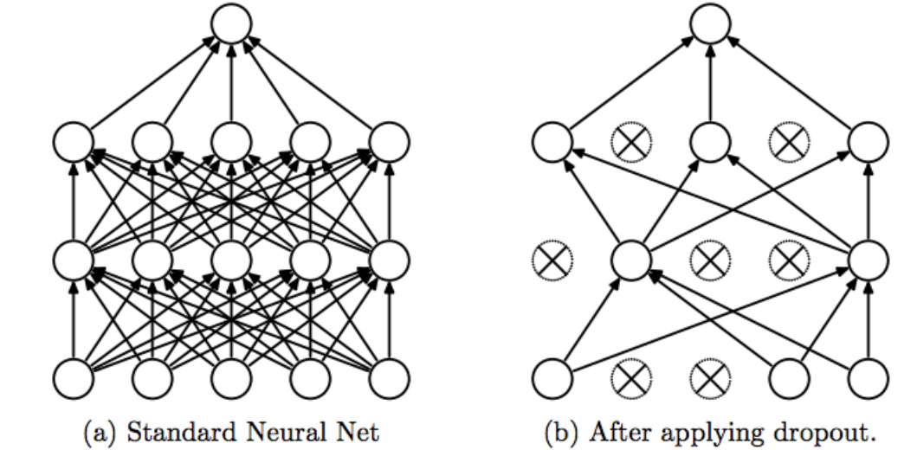
Ensembling with just 1 training: dropout
During training, at each step knock out some (different) randomly chosen connections.
When predicting, use all connections (you need to introduce a normalising constant for this to work correctly).
This is equivalent to having a very large ensemble of networks, but you train only once!

Slide 10
Online versus batch learning
Online learning zig-zags around the direction of steepest descent.
Batch learning does steepest descent on the error surface
w1
w1
w2
Connectionist Computing COMP 30230
w2

Slide 11
Batch and online
Batch learning is theoretically more sound.
Online learning can be a lot faster: one step for each example vs one step for the whole training set.
Intermediate versions are also possible, for instance update after every group of X examples, where X is smaller than the size of the training set.
In practice it depends on the problem, the format of the input, etc. if online learning is applicable. Trial and error..
Connectionist Computing COMP 30230

Slide 12
More gradient descent problems
The direction of steepest descent does not necessarily point at the minimum.
Can we preprocess the data or do something to the gradient so that we move directly towards the minimum?
Connectionist Computing COMP 30230

Slide 13
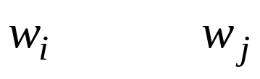
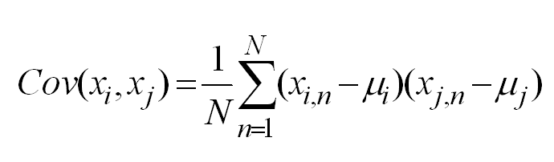
Fixing up the error surface
Preprocess each input so that it isn’t correlated to the others
The gradient will now point at the minimum
This means computing the covariance matrix among all the outputs (OK), inverting it (not OK, if there are many inputs), and multiplying each input by the inverse.
i
j
Suppose that inputs i and j are highly correlated. Changing wi will change the error in the same way as changing wj.
So changing both will have larger effects on E than changing a weight that isn’t correlated to the others
Connectionist Computing COMP 30230

Slide 14
Yet another GD problem
The gradient is large where the error is steep, small where the error is flat.
In general, this is a silly way of going. We would like to run where it’s flat and boring and go cautiously where it gets steep.
Connectionist Computing COMP 30230

Slide 15
..fixing it
Use an adaptive learning rate
  Increase the rate slowly if it’s not diverging
  Decrease the rate quickly if it starts diverging
Use momentum
  Instead of using the gradient to change the position of the weight, use it to change the velocity of change.
Use fixed step
  Use gradient to decide where to go, but always go at the same pace.
Connectionist Computing COMP 30230

Slide 16
Back to learning
Supervised Learning (this models p(output|input))
  Learn to predict a real valued output or a class label from an input.
Unsupervised Learning (this models p(data))
  Build a causal generative model that explains why some data vectors occur and not others
    or
  Learn an energy function that gives low energy to data and high energy to non-data
    or
  Discover interesting features; separate sources that have been mixed together, etc. etc.
Reinforcement learning (this just tries to have a good time)
  Choose actions that maximise payoff
Connectionist Computing COMP 30230

Slide 17
Reinforcement learning
The basic paradigm of reinforcement learning is as follows: The learning agent observes an input state or input pattern, it produces an output signal [..], and then it receives a scalar "reward" or "reinforcement" feedback signal from the environment indicating how good or bad its output was.
The goal of learning is to generate the optimal actions leading to maximal reward.
[Tesauro ’94]
Connectionist Computing COMP 30230

Slide 18
Reinforcement learning
In many cases the reward is also delayed (i.e., is given at the end of a long sequence of inputs and outputs). In this case the learner has to solve what is known as the "temporal credit assignment" problem (i.e., it must figure out how to apportion credit and blame to each of the various inputs and outputs leading to the ultimate final reward signal).
[Tesauro ’94]
Connectionist Computing COMP 30230

Slide 19
TD-gammon
“A neural network that trains itself to be an evaluation function for the game of backgammon by playing against itself and learning from the outcome”.
The appealing thing here is learning without a teacher (at least, without a full time one).
Connectionist Computing COMP 30230

Slide 20
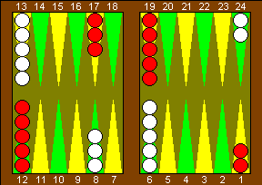
Backgammon
A two-player game, played on a one-dimensional track (although represented on a 2D board).
Players take turns, roll 2 dice, move their checkers along the track based on the dice outcome.
Win: moving all the checkers all the way to the end, and off the board.
Gammon (double win): a player wins when the other still hasn’t taken any checkers off the board.
Connectionist Computing COMP 30230

Slide 21
Backgammon
Hitting a checker: landing on it, when it’s alone; it is sent all the way back.
Blocking: it is possible to build structures that make it difficult to move forward for the opponent.
Connectionist Computing COMP 30230

Slide 22
Backgammon complexity
Large: 21 possible dice outcomes, for each of which about 20 legal moves.
Brute force approach isn’t feasible.
In general we need to develop positional judgement, rather than trying to look ahead explicitly: a position is good or bad per se.
Connectionist Computing COMP 30230

Slide 23
Neurogammon
Previous approach by Tesauro. MLP trained in a supervised fashion on a training set of moves by human experts.
A lot of tricks (features) included.
Problem: human experts are fallible; ideas about what constitutes a good move are revised all the time.
Neurogammon was a good player (best program) but far from the best humans.
Connectionist Computing COMP 30230

Slide 24
TD-gammon
The network: simply an MLP
General learning idea: the network plays against itself, and considers as a positive example a winning sequence of moves (and perhaps as a negative example a losing one).
Connectionist Computing COMP 30230

Slide 25
TD-gammon: inputs and outputs
The inputs x[1], x[2], .. x[f] are the board positions during a game. They are encoded into the network in some way.
Output y[t] is a four component vector that estimates the final outcome (judges positions): White win, Black win, White gammon, Black gammon.
(When playing, all the moves associated with a die roll are evaluated and the best one picked.)
Connectionist Computing COMP 30230

Slide 26
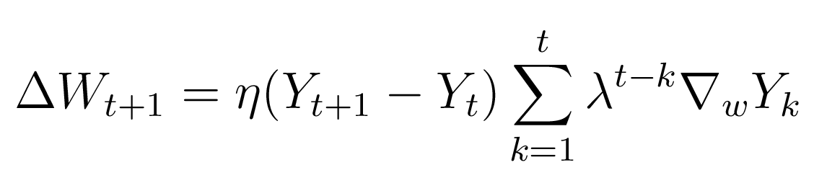
TD-gammon: learning
Update is based on the TD (time differences) rule:
At the final step, Y is known, so the reward is entered into the network.
Connectionist Computing COMP 30230

Slide 27
Time credit
The parameter λ controls time credit assignment, i.e. how far ahead an action influences learning. λ=1 means that each past action is considered equally important to determine the outcome at time t. λ=0 means no memory.
Connectionist Computing COMP 30230

Slide 28
Training results
At the beginning the network plays randomly: very long games, not much sensible learning.
Still, elementary strategies are quickly learned.
Best network: 40 hidden units, 200,000 games. Roughly as good as Neurogammon.
Connectionist Computing COMP 30230

Slide 29
Adding features
Instead of just coding the raw configurations, encode knowledge-based features of the configuration into the network.
With these features TD-gammon outperforms Neurogammon.
Version 2 achieved near-parity with world class level human players.
Version 3.1 has a look ahead strategy and longer training: it is unbeatable by humans.
Connectionist Computing COMP 30230

Slide 30
Strengths of TD-gammon
According to experts:
still makes some small mistakes at tactical game, where variations can be calculated out; no wonder, it does not calculate them..
is tremendous at vague positional battles, where what matters is evaluating a pattern
humans have learned from it
Connectionist Computing COMP 30230

Slide 31
“Instead of a dumb machine which can calculate things much faster than humans such as the chess playing computers, [..] a smart machine which learns from experience pretty much the same way humans do.”
Connectionist Computing COMP 30230

